Slide 1
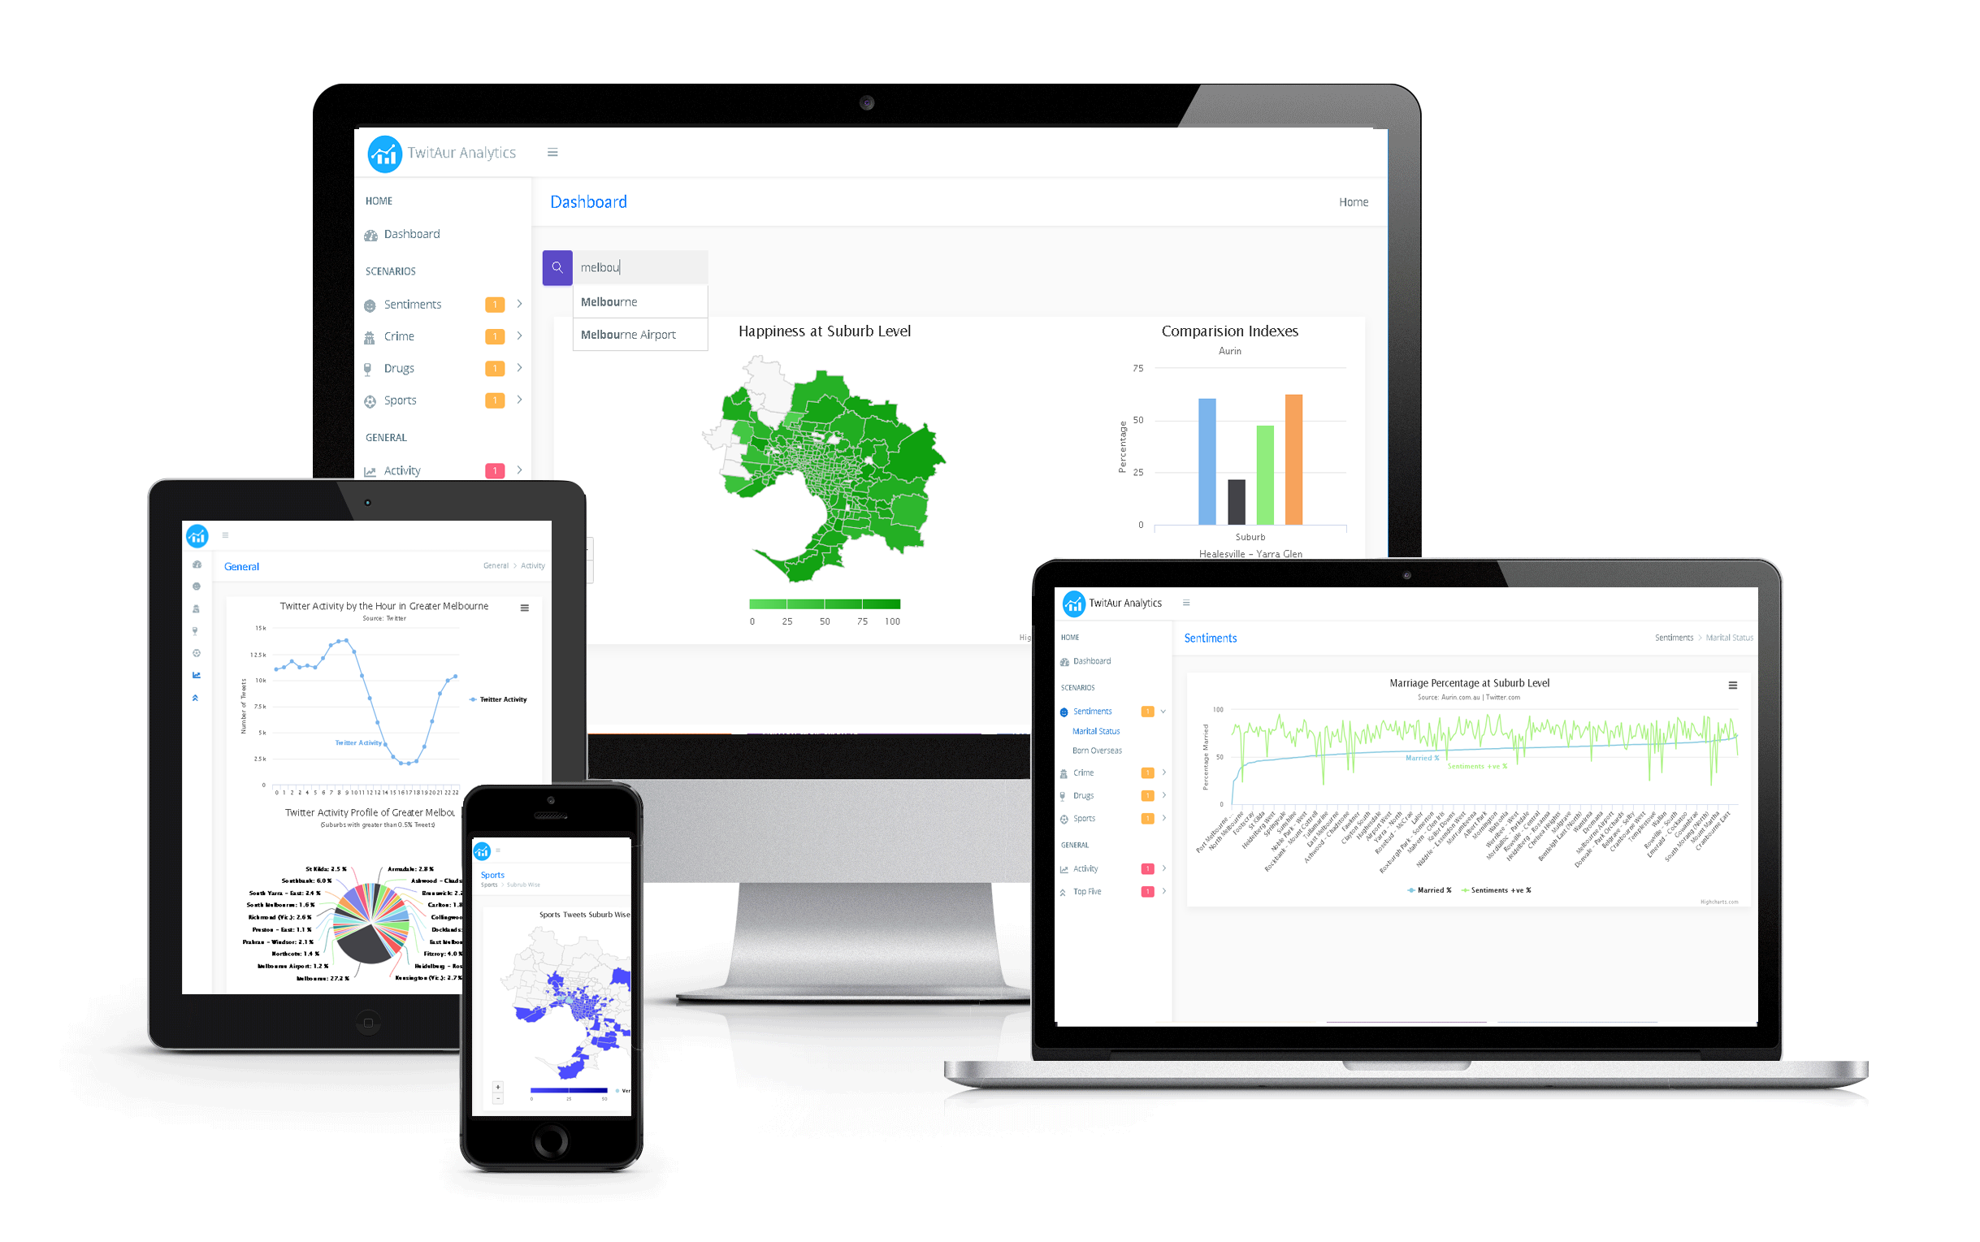
Assignment 2
COMP90024
Team 48
Muhammad Umair, 863579
Kriti Bhardwaj, 880873
Haaris Nazir Ahmed, 869969
Sergey Germogentov, 893900

Slide 2
Roles and Responsibilities
Infrastructure
MU -HA
Data Science
KB –MU/HA
Automation
SG –MU/HA
User Interface
MU –KB/HA
Section
Lead –Contributors
MU –Muhammad Umair
KB –Kriti Bhardwaj
SG –Sergey Germogentov
Haris Ahmed

Slide 3
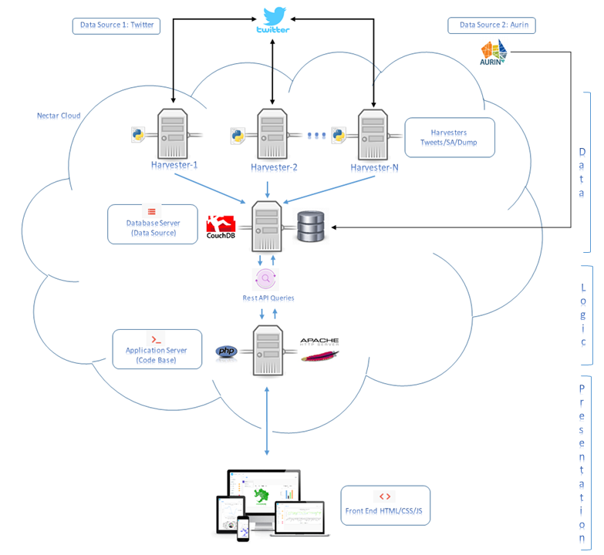

Slide 4
Demo -TwitAur

